Slide 1
New Community Solar Financial Model for Fall 2021
Paul Gilman
2021 SAM Webinars
September 15, 2021

Slide 2
SAM Webinars for 2021
Merchant Plant Financial Model August 4
New Battery Model Features August 18
New Community Solar Financial Model September 15
Electricity Bill Calculator Updates September 29
Register for free at: https://sam.nrel.gov/events.html
Find webinar recordings at https://sam.nrel.gov/

Slide 3
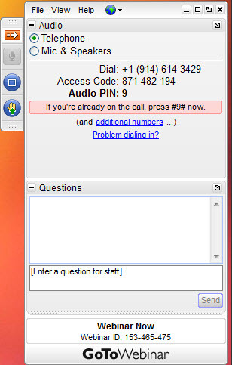
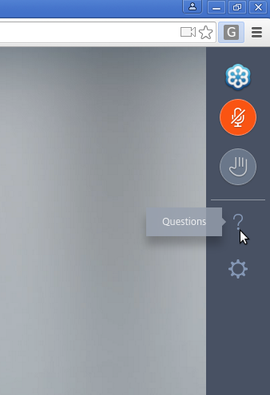
Questions and Answers
Instant Join Viewer
Desktop application
We will either type an answer to your question or answer it at the end of the presentation.

Slide 4
Outline
Background
Model overview
Demo
Questions and answers

Slide 5
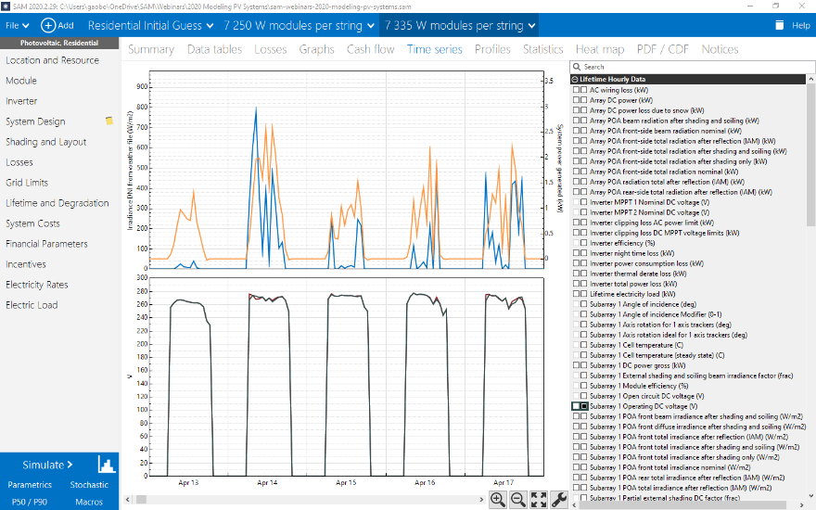
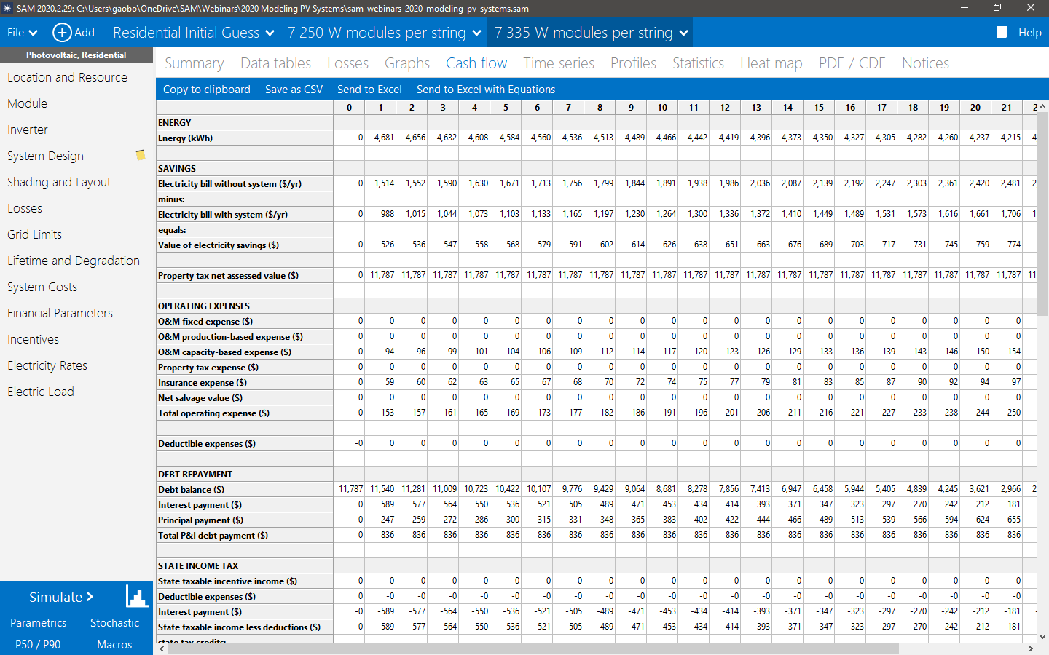
What is SAM?
The System Advisor Model
Free computer software developed and distributed by the U.S. Department of Energy’s National Renewable Energy Laboratory
Calculates:
A power system’s energy output over one year
A power project’s cash flow over years of operation
“Introduction to SAM 2020.2.29” https://sam.nrel.gov

Slide 6
Community Solar
Financing mechanism that allows a group of people to invest in and benefit from a solar power project
System owner
  Installs and operates the system
  Manages the community solar project
Subscribers
  Pay to participate in the project
  Benefit from a reduction in their electricity bill
Notes:
Community solar is a financing mechanism that allows a group of people to invest in and benefit from a solar power project.
Community solar projects are complicated to model because they involve many different partners, involve a wide range of costs, and use a wide range of mechanisms to cover those costs. They are also subject to rules and requirements that vary by location.
SAM’s Community Solar model is designed to provide high-level insights into the cost-effectiveness of community solar for potential partners in a specific community solar project, or for people involved in designing or evaluating the design of a community solar program.
SAM’s cash flow model calculates the cost of installing, owning, and operating a solar power system that is part of a community solar project. It considers a system owner who owns and operates the system and also manages the community solar project, and subscribers who pay to participate in the system and benefit from a reduction in their electricity bill.

Slide 7
System owner perspective
System
  Physical system’s design
  Cost of installing and operating the system
  Project financing and incentives
Community solar project
  Costs associated with acquiring and managing subscribers
  Revenue from subscriber payments
Notes:
The system owner perspective involves the solar power system’s design, project costs, and financing, and the community solar project costs and revenue.
The “system” includes the design of the system, such as its location, size, photovoltaic array orientation, shading, and other aspects of the physical system. It also includes the cost of installing and operating the system, such as equipment purchases, labor, permitting and interconnection costs; and project financing including debt, taxes and incentives.
The community solar project includes costs associated with acquiring and managing subscriptions and revenue to the project from subscriber payments.

Slide 8
System owner perspective
System
  Physical system’s design
  Cost of installing and operating the system
  Project financing and incentives
Community solar project
  Costs associated with acquiring and managing subscribers
  Revenue from subscriber payments
Based on Single Owner
New for Community Solar
Notes:
If you are already familiar with SAM, the system design, costs, financial parameters and incentives will be familiar because they are the same as those for the PPA Single Owner financial model. The new Community Solar model has additional inputs for subscriber share, and costs and revenue associated with the community solar project.
For those of you who have been using the Single Owner model for community solar projects, the transition to the new model should be easy.

Slide 9
Community solar costs
Costs are rolled up into two categories
  Up-front cost
  Subscriber acquisition
  Marketing
  Recurring cost
  Outreach
  Sales
  Customer service
  Billing
Notes:
As with the other financial models in SAM, we have tried to design the Community Solar model to have enough detail to cover different modeling scenarios, but not so much detail that it is too difficult to learn and use.
The community solar costs are divided into an up-front cost in Year 0 of the project cash flow and a recurring cost that occurs in Years 1 through the project life.
You may have a detailed cost model for your project with multiple categories of up-front and recurring costs. If that is the case, you’ll need to do some processing outside of SAM to add up those costs so they fit SAM’s categories.

Slide 10
Revenue from subscriber payments
Payments from up to four subscriber classes can be any combination of
  Up-front payment, $ in Year 0
  Recurring payment, $ in Years 1 through analysis period
  Sum of monthly subscription
  Generation payment, $/kWh in Years 1 through analysis period
  Based on subscriber share of system
Notes:
The Community Solar project can earn revenue from different kinds of subscriber payments.
An up-front payment is a one-time subscription fee that subscribers pay to join the project in Year 0 of the project cash flow.
A recurring payment is an annual subscription fee. Typically, subscribers would pay a monthly subscription fee, but because SAM’s cash flow is annual, you’ll need to add up those monthly payments to provide the annual value to SAM.
A generation payment is an annual payment for a portion of the electricity generated by the system that depends on the subscriber share of the system.

Slide 11
Subscriber classes
Up to four classes
Subscriber class share of system is percentage of system capacity in kW
Unsubscribed share with an associated $/kWh rate
Option to specify a bill credit rate by class to evaluate value of participation from subscriber perspective
Notes:
SAM supports up to four subscriber classes.
You will allocate a share of the system to each subscriber class. Each subscriber’s share can be fixed or grow (or decline) over the project life. You can also specify the subscriber share by year if you expect subscriber share to change irregularly.
An option is available to specify an unsubscribed rate for projects that earn revenue from the unsubscribed portion of the project.
The bill credit rate provides a way to assess the value of participating in the project from the perspective of each subscriber class.

Slide 12
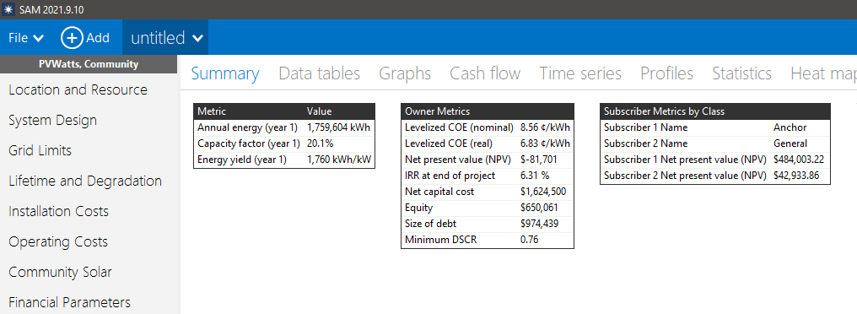
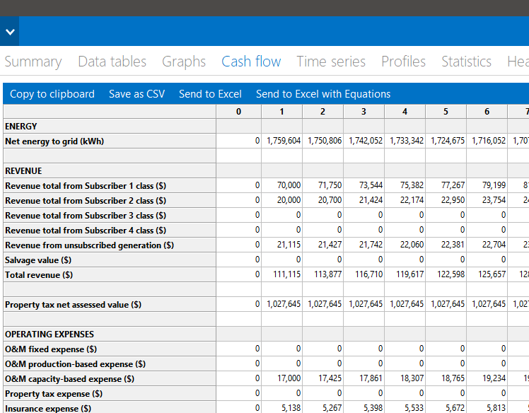
Model results
Project net present value (NPV)
Project cash flow
Subscriber NPV
Notes:
SAM generates a complete set of results for the Community Solar model, including hourly or subhourly time series performance data and annual cash flow line items for the financial model.
The primary output metrics for the Community Solar model are the project net present value, which is calculated from the project net after-tax cash flow, and the subscriber NPV if you are considering the subscriber perspective.
Remember that the NPV is a metric that considers all of the project costs and benefits starting with the year the system is installed through the end of the analysis period: A positive NPV indicates a project earns sufficient revenue to cover costs and earn a return, and a negative NPV indicates the project costs more than the revenue it generates.

Slide 13
Thank you!

